Slide 1

Software Engineering
Pre-work: Day 4

Slide 2

Learning Objectives
Explain what Javascript is used for
Learn programming fundamentals
Learn how to use javascript with your HTML

Slide 3

What is Javascript?
Javascript (not to be confused with the Java) is a programming language that allows you to add complexity to a web page and make it interactive. You can use Javascript to deal with user input, animations, updating content, etc. Just like how HTML is the “skeleton” and CSS is the “skin” of a site/app, Javascript would be the “brain” which gives a website/app functionality.

Slide 4
Basic Data Types
Strings
Numbers
Booleans

Slide 5
Strings
Example
‘This is a string.’
“This is also a string.”
A string is simply a series of unicode characters, or text. Anything inside “quotation marks” is considered a string in Javascript.
You can use ‘single’ or “double” quotes around a string literal.

Slide 6
Numbers
Example
45 is a number
45.59 is also a valid number
This data type is self explanatory. Javascript can use numbers both with and without a decimal.

Slide 7
Booleans
A boolean is a True or False value. A boolean is used when checking to see if a certain condition is met or not.

Slide 8
Variables
Variables are nothing but reserved memory locations to store values. This means that when you create a variable you reserve some space in memory. Based on the data type of a variable, the interpreter allocates memory and decides what can be stored in the reserved memory.
A few rules for naming variables:
Variable names can only contain letters, numbers, and underscores.
They can start with a letter, but not with a number.
Spaces are not allowed in variable names, but writing in camelCase can be used to separate words in variable names.
Avoid using Javascript keywords and function names as a variable name.

Slide 9
Variables using let and const
When creating a variable in javascript, you MUST first initialize it by using the keyword let or const.
let is used when you know the value of your variable is going to change.
const is used when you want a variable’s value to remain constant and never change.
In order to change the value or a variable you just need to have the variable equal to a new value. When changing the value of a variable you do not need to use let or const since it has already been initialized.
Example
let firstVariable = “Saving this string to my variable”;
firstVariable = “The value has now changed”;
const secondVariable = “This value cannot change”;
const myNumber = 13;
const myBoolean = true;
Note: You will sometimes see the keyword var being used when initializing a variable. This keyword is outdated and should not be used.

Slide 10
Console.log()
Console.log() is a function that allows you to print a value to your terminal or the console in your browser. This is something you will utilize over and over when you code.
To log anything to your terminal you simply add the value inside of the parenthesis.
You can log any data type.
Example
const hello = “Hello World”;
console.log(“I’m logging this string”);
console.log(13);
console.log(hello) ; <-- This will print “Hello World”

Slide 11
Using Javascript in your HTML
Example
<!DOCTYPE html>
<html>
<head>
</head>
<body>
<h1>Connect Javascript</h1>
<script>
const hello = “Javascript connected!”;
console.log(hello);
</script>
</body>
</html>
In order to use Javascript in your website/app simply add script tags the the body element of your HTML.
The script tag should always be under ALL of the other elements that live inside the body.
All of your javascript code belongs inside of these script tags.

Slide 12
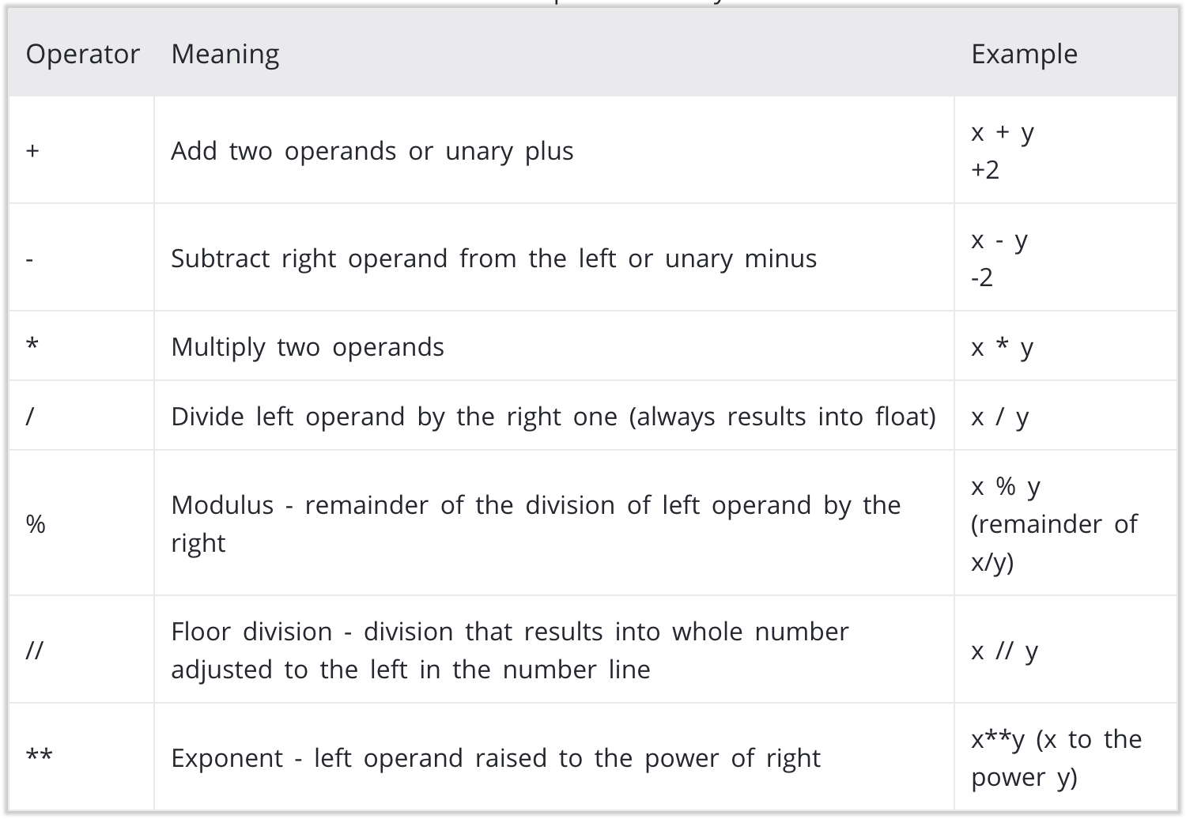
Arithmetic Operators in Javascript
Arithmetic Operators perform calculations between operands.
Example
const sum = 2 + 5
console.log(sum); ← prints the number 7
const difference = 7 - 3
console.log(difference); ← prints the number 4

Slide 13
Arrays
Example
const apartment = ['kitchen', 'bathroom', 'bedroom', 'living']
const emptyArray = [] const numbers = [1, 2, 3] const myArray = [1, "Hello", 3.4]
An array can even have another array as an item. This is called a nested array.
moreArrays = ["mouse", [8, 4, 6], ['a']]
In Javascript programming, an array is created by placing all the items (elements) inside a square bracket [ ], separated by commas. It can have any number of items and they may be of different data types (number, string, boolean etc.).

Slide 14
Accessing and adding array items
Every element in an array has an index, starting with 0, meaning the first item in an array has an index of 0, the second item an index of 1, so on and so forth. To retrieve an element from an array, use the array name and [index of the element]:
apartment[0]
Output >>> ‘kitchen’
Adding to an array
Use the .push( ) method to add another item to the end of a list,
apartment.push(‘office’)
console.log(apartment)
Output >>> [‘kitchen’, ‘bathroom’, ‘bedroom’, ‘livingroom’, ‘office’]

Slide 15
Objects
An object contains a mapping of keys to values. Each key is connected to a value, and you can use a key to access the value associated with that key. It is a mutable data type, meaning you can edit the values.
statesAndCapitals = {
‘New York’: ‘Albany’,
‘Arizona’: ‘Phoenix’,
‘Colorado’: ‘Denver’
}
Adding another key-value pair to a dictionary.
statesAndCapitals[‘Hawaii’] = ‘Anchorage’ OR statesAndCapitals.Hawaii’ = ‘Anchorage’ <<< This is called “dot notation”
Changing the value of a key in the dictionary:
statesAndCapitals[‘Hawaii’] = ‘Honolulu’ OR statesAndCapitals.Hawaii’ = ‘Honolulu’ <<< This is called “bracket notation”
IMPORTANT
You can only use dot notation when the key is one word. If the key has a space you will need to use square brackets with quotes to access its value.

Slide 16
How to create a object?
# empty object myObj = {}
# object with integer keys
myObj = {
1: 'apple',
2: 'ball'
}
# object with mixed keys
myObj = {
name: 'John',
1: [2, 4, 3]
}
Creating an object is as simple as placing items inside curly braces { } separated by a comma.
An item has a key and the corresponding value expressed as a key: value pair.
While values can be of any data type and can repeat, keys must be a string or a number and must be unique.

Slide 17
Loops
In programming, a loop is a set of instructions that runs over and over as long as a certain condition is true. With a loop, you can iterate over a collection object, such as an array or an object.
Javascript offers two kinds of loops, the for loop and the while loop.

Slide 18
What is for loop in Javascript?
Syntax of for Loop
for (initializer; condition; increment expression) {
[statement]
}
Example
for (let i = 0; i <= 10; i++) {
console.log(i);
}
>>>> Runs 10 times and console logs numbers 0 - 9.
A for loop repeats until a specified condition evaluates to false.
Looking at the syntax example on the right, a for loop can be broken down into 4 parts. The initializer, condition, increment expression and the statement.

Slide 19
For loop breakdown
The initializer starts the counter, in this example case we created a variable called i and set it to 0.
The condition is what has to evaluate to true in order for the loop to run.
If the condition is true, the statement, which is your code, will run.
The increment expression then adds or subtracts from the counter (variable i). The loop then checks if the condition is still true and runs again if it’s true. This will continue until the condition is false.
Syntax of for Loop
for (initializer; condition; increment expression) {
statement;
}
Example
for (let i = 0; i <= 10; i += 2) {
console.log(i);
}
>>>> Runs 5 times and console logs numbers 0, 2, 4, 6, 8.
Note: i++ increments the i variable by 1 and i-- decrements the i variable by 1. You can also write the same expression by writing i += 1 & i -= 1. Doing it this way lets you increment or decrement by any number.

Slide 20
What is a while loop in Javascript?
Syntax of for Loop
while (condition) {
statement;
}
Example
while (true) {
console.log(“Looping”);
}
>>>> Infinitely logs “Looping” and does not stop because the condition is always true.
Like a for loop, a while loop repeats until a specified condition evaluates to false.
Looking at the syntax example on the right, a while loop takes in a condition and as long as it’s true, your statement (your code) will run.
Because the condition in the example is the boolean true and never changes, the loop will run infinitely, breaking your program.

Slide 21
Breaking out of a while loop
In order to break out of a while loop and control how many times your code loops, you can create a variable OUTSIDE of the while loop which holds a number, like the initializer in a for loop.
You can then change your condition accordingly and increment or decrement your variable inside of the while loop to ensure the condition eventually equals false.
Example
let i = 0;
while (i < 5) {
console.log(“Looping”);
i++;
}
>>>> Logs “Looping” 10 times.

Slide 22
Break statement
There is another way to break out of any loop and that’s with the break statement. This automatically breaks you out of a loop regardless of whether or not a condition is true.
Example
let i = 0;
while (i < 5) {
console.log(“Looping”);
I++;
break;
}
>>>> Logs “Looping” 1 time.
Example
for (let i = 0; i < 5; i++) {
console.log(“Looping”);
break;
}
>>>> Logs “Looping” 1 time.

Slide 23


